Slide 1

Predicting Self-Reported Stress Levels: The Role of Screen Time, Social Media, and Lifestyle Factors
Notes:
Hello everyone. Today I’m presenting my project, Predicting Stress from Screen Time and Lifestyle Habits. The goal of this work is to understand how everyday behaviors—especially screen time and sleep—affect how stressed people feel, and how we can use data to predict stress levels.

Slide 2
Business Problem
Stress levels are rising in the U.S. (American Institute of Stress, 2025).
Digital overload and poor lifestyle habits make it worse.
Goal: Use data on screen time, social media, sleep, and exercise to predict self-reported stress.
Helps companies and individuals act before stress causes burnout.
Notes:
Stress is an extremely common problem in the U.S. Research from the American Institute of Stress shows stress levels continue to rise, and it impacts everything from work productivity to physical and mental health.
At the same time, people spend more hours than ever on screens and social media. This project asks an important question: Can we use data about screen time, sleep, and lifestyle habits to predict how stressed a person feels?
If we can, then individuals, workplaces, and wellness programs can use that information to intervene earlier and prevent burnout.

Slide 3
Background/History
Stress has become a national concern.
Heavy screen time, poor sleep, and financial worries are key factors.
Exercise and rest reduce stress (Harvard Health Publishing, n.d.).
Data-driven prediction allows early stress detection and intervention.
Notes:
Stress doesn’t come from just one source. It includes financial worries, work pressure, news overload, and lack of sleep. But one factor that keeps coming up is digital overload. Constant screen exposure makes it hard to disconnect, and poor sleep makes stress worse the next day.
On the other hand, research from Harvard Health Publishing shows that exercise and healthy routines can help lower stress.
This project builds on those ideas by looking at real data on people’s habits and self-reported stress.

Slide 4
The Data
Dataset: Kaggle (2023) Survey on Screen Time and Mental Wellness.
~500 records with:
Stress level (1-10)
Daily screen time
Sleep quality
Exercise frequency
Social media use
Happiness index
Data cleaned and encoded for modeling.
Notes:
The dataset I used came from Kaggle and includes about 500 survey responses. People reported their daily screen time, their sleep quality, their exercise habits, their social media usage, and their happiness level.
The target variable was a simple 1–10 stress rating. The data was clean, so I only needed to encode text fields like gender and platform type. Overall it was very well structured and ready for modeling.

Slide 5
Methods
Models tested:
Linear Regression
Random Forest
Gradient Boosting
80/20 train-test split Metrics: R², RMSE Goal: Find most accurate and interpretable model.
Notes:
To explore the data, I ran charts, correlations, and visual comparisons.
For prediction, I tested three models:
Linear regression
Random forest
Gradient boosting
I used an 80/20 train-test split and evaluated performance using R² and RMSE.
The goal wasn’t just accuracy—it was also to understand which factors matter most for stress.

Slide 6
Key Findings
Screen time strongly increases stress.
Sleep quality reduces stress.
Exercise and social media use had weak relationships.
Best model: Random Forest (R² = 0.62)
Screen time and sleep explained most of the variance.
Notes:
What stood out immediately was the strength of the relationships. Screen time had a very strong positive correlation with stress. Sleep quality had a strong negative correlation with stress.
Exercise and social media use were much weaker predictors than expected.
When I compared models, Random Forest performed the best with an R² of about 0.62. That means it explained around 62% of the variation in stress levels, which is solid for behavioral data.
But the most important insight is that screen time and sleep quality were the biggest predictors no matter which model I used.

Slide 7
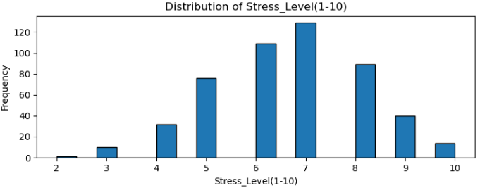
Visual Insights
Notes:
On this slide, we’re looking at the distribution of stress levels reported in the dataset. Each bar represents how many people selected each stress rating from 1 to 10.
What stands out immediately is that most people fall into the moderate to high stress range. The highest frequencies appear at stress levels 6, 7, and 8, with level 7 being the most common overall. That means a large portion of the sample is experiencing noticeably elevated stress.
On the opposite end, very few participants reported low stress levels, especially in the 2–4 range. This tells us that low stress is actually uncommon in this group, and high stress is the norm rather than the exception.
This distribution also helps set the stage for the rest of the project. Since so many people are concentrated at higher stress levels, it becomes especially valuable to understand what lifestyle factors—like screen time or sleep—are contributing to these elevated scores.
So overall, this chart shows us that stress isn’t evenly distributed. It’s weighted heavily toward the higher end, which makes predicting and managing stress an important challenge.

Slide 8
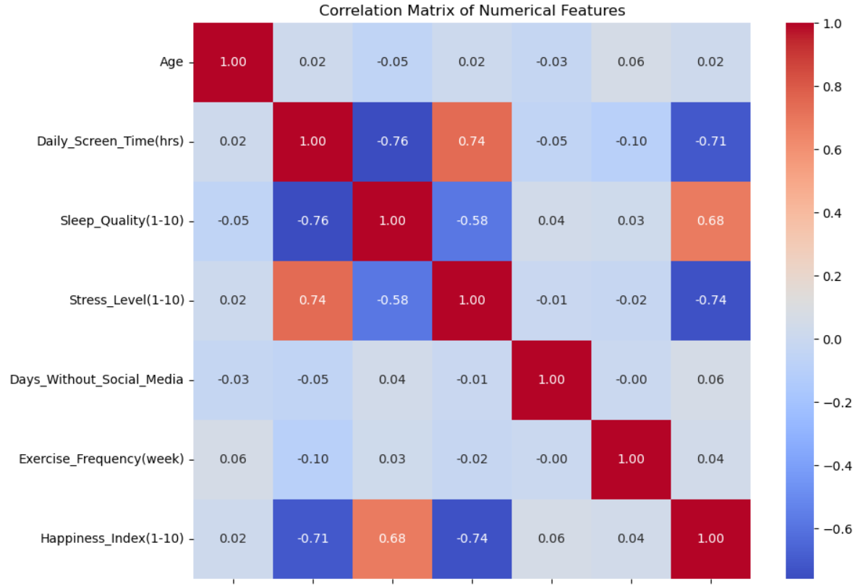
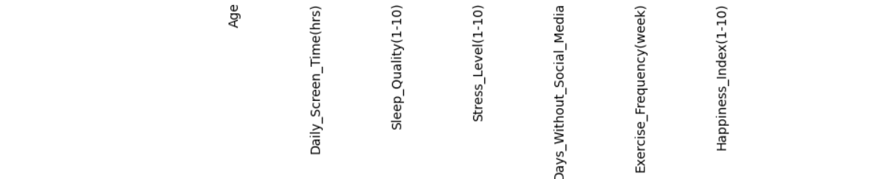
Visual Insights
Notes:
This heatmap shows how each variable relates to stress and to the other habits in the dataset.
The strongest pattern is that screen time and stress are highly positively correlated—the more time people spend on screens, the more stressed they tend to be.
We also see that sleep quality has a strong negative correlation with stress, meaning better sleep is linked to lower stress.
Screen time and sleep quality are also strongly negatively related, which suggests screen time may indirectly affect stress by hurting sleep.
Happiness moves in the opposite direction of stress as well, which makes sense.
Other features like exercise and days without social media show almost no relationship with stress in this dataset.
Overall, this heatmap confirms that screen time and sleep are the main predictors of stress, and they are strongly connected to each other.”

Slide 9
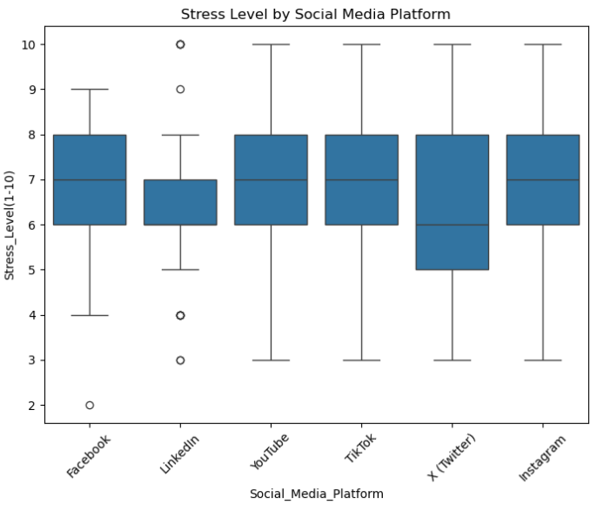
Visual Insights
Notes:
This chart compares stress levels across different social media platforms. The key point is that the differences are very small.
All platforms show similar median stress levels—mostly around 6 or 7. There’s no platform that clearly causes higher or lower stress in this dataset.
We do see some outliers, but overall the spread is almost the same across Facebook, LinkedIn, YouTube, TikTok, Twitter, and Instagram.
This tells us that social media platform choice isn’t a strong predictor of stress compared to screen time or sleep.

Slide 10
Conclusion
Screen habits and sleep patterns predict stress reliably.
Moderate success predicting stress (±1 level).
Supports well-known wellness advice: rest more, limit screen time.
Data can guide personalized stress management tools.
Notes:
In summary, it is absolutely possible to predict stress fairly accurately using simple lifestyle data.
People with higher screen time tend to have higher stress. People with better sleep have lower stress.
This reinforces what many health experts explain: Reduce screen overload and protect your sleep if you want to manage stress.
The model won’t replace a medical evaluation, but it can be a helpful early warning system.

Slide 11
Implementation Plan
Collect lifestyle data via app or survey
Use stress prediction model for feedback
Provide wellness tips (sleep, screen limits).
Keep data private and voluntary
Monitor accuracy and update model regularly
Notes:
To put something like this into practice, you would start by collecting screen time and lifestyle data—usually through a phone app or a wearable device.
The model could then run predictions weekly or daily and give feedback, such as: ‘Your screen time this week suggests your stress may be increasing. Consider taking breaks or improving your sleep routine.’
For organizations, this could be offered as an optional wellness tool. The key is that the data remains private, voluntary, and supportive—not something used for evaluation or monitoring productivity.

Slide 12
Ethical Considerations
Informed consent and data privacy are required.
Use predictions for support, not punishment.
Avoid bias or misuse (e.g., by employers or insurers).
Transparency builds trust in predictive tools.
Notes:
There are important ethical issues tied to predicting stress. First is privacy. People must give full consent and understand how their data will be used. Second is fairness. The model must avoid bias and should not be used to penalize anyone. Third, it should support people, not surveil them.
The focus must stay on well-being, transparency, and personal choice. When used responsibly, this type of predictive insight can be very helpful.

Slide 13
Questions
Notes:
Thank you for listening. I’m happy to answer any questions about the methods, models, or how this type of analysis could be used in real-life wellness programs.
1. How accurate is the model really, and what does an R² of 0.62 mean in real life?
An R² of 0.62 means the model explains about 62% of the differences in people’s stress scores. For a behavioral dataset—where people are all different and stress has many causes—that is actually pretty strong. It won’t predict someone’s stress perfectly, but it gives a good estimate within about one point on the stress scale.
2. Would the model work differently with older adults or different populations?
Probably, yes. Most people in this dataset were younger adults, so the patterns reflect that group. Older adults, teenagers, or stressed professionals might have different habits. The model is a good starting point, but it would need more diverse data to be used broadly.
3. Why did the Random Forest model perform better than linear regression?
Random Forest captures nonlinear relationships, meaning it can detect more complicated patterns between lifestyle habits and stress levels. Linear regression assumes the relationships are straight-line and simple. Human behavior is rarely simple, so Random Forest did better.
4. If you added more data, like income or job type, do you think accuracy would improve?
Most likely, yes. Stress has many causes—finances, workload, living situation—none of which were in the dataset. Adding more meaningful features usually improves accuracy because the model sees more of the full picture.
5. How often would someone need to update their data for the model to stay accurate?
Weekly updates would work well. Stress, sleep, and screen time all change quickly, so frequent updates help the model reflect a person’s current lifestyle. If this were an app, updating automatically every day would be ideal.

Slide 14
References
American Institute of Stress. (2025). What the latest reports say about stress in America. https://www.stress.org/news/what-the-latest-reports-say-about-stress-in-america/
Harvard Health Publishing. (n.d.). Exercising to relax. https://www.health.harvard.edu/mind-and-mood/exercising-to-relax
Kaggle. (n.d.). Screen Time vs Mental Wellness Survey (2023). https://www.kaggle.com/datasets/adharshinikumar/screentime-vs-mentalwellness-survey-2023

